Slide 1
CSC216 Comparison: Fall 2015 and 2016
By Adam Abram

Slide 2
Primary Question & Hypothesis
How are classrooms impacted by…
Renaming assignments
Integrating labs into a larger project
Increasing the number of labs and guided projects
Implementing Process Points
We hypothesize that these interventions will result in an increase of:
Retention: How many students pass the class, and remain in CS
Efficacy: The belief that students are capable of learning CS
Learning: How well the students picked up the material
Engagement: Use of office hours and message boards

Slide 3
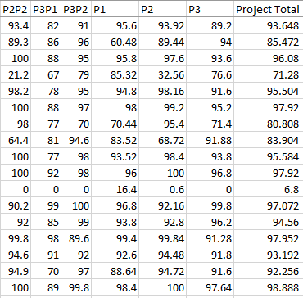
Metrics
Data collection
Grade Data
Pre & Post Survey
Office Hours and Message Board data

Slide 4
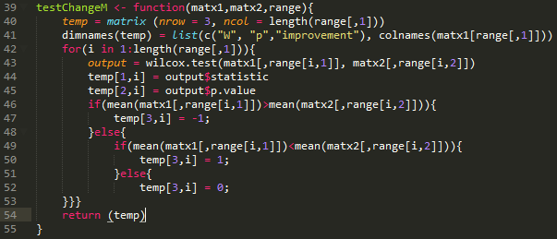
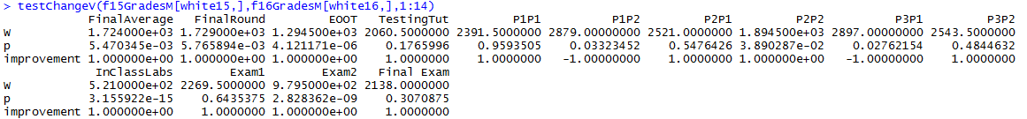
Methodology
Scripts
Aim for versatility
Aim for consistency
Aim for legibility
The primary test used was the Mann-Whitney test

Slide 5
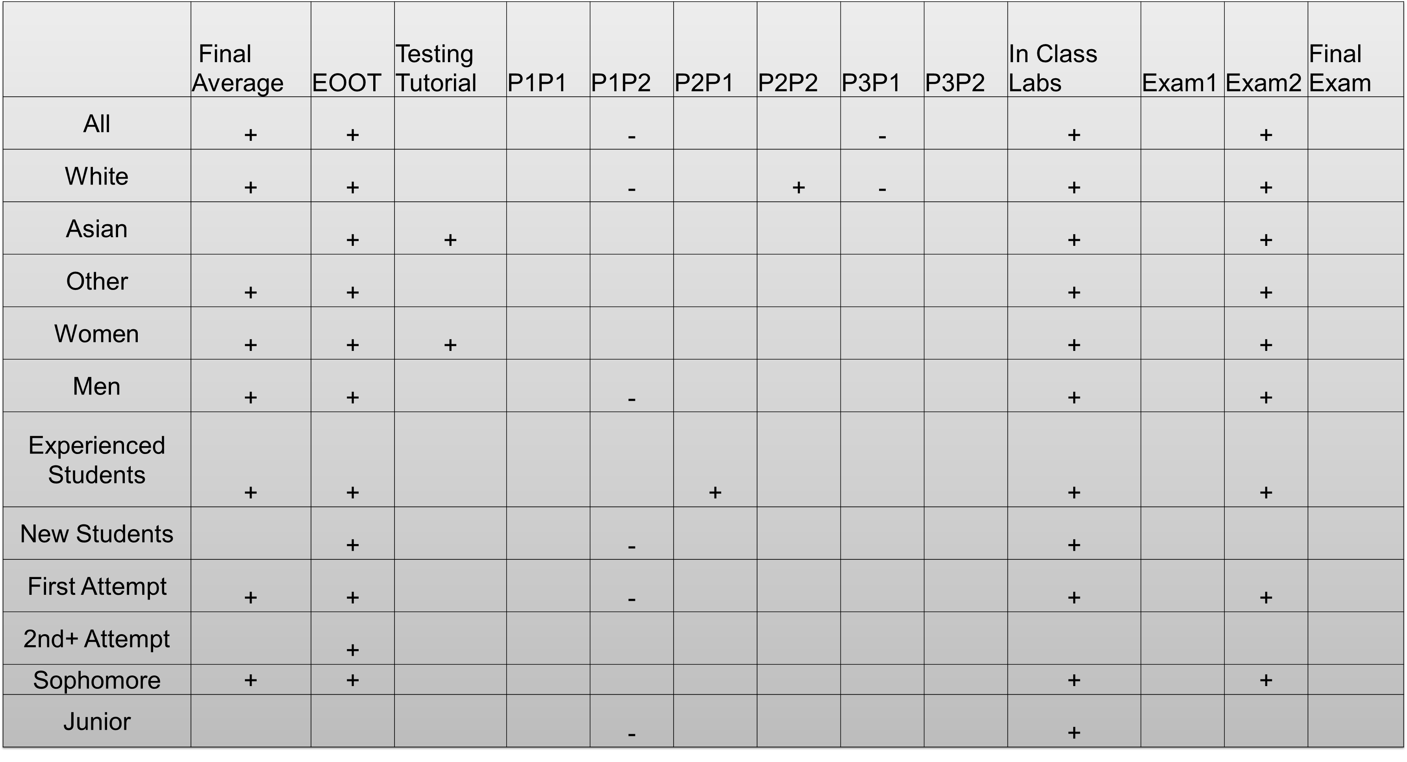
Results & Conclusions
The renaming of EOOT was effective
The modifications to the labs was successful
The inclusion of Process points was not successful
As a whole, the interventions were helpful

Slide 6
Possible Explanations
Process Points may have been seen as unimportant by students
The inheritance lab was responsible for improving exam 2 grades

Slide 7
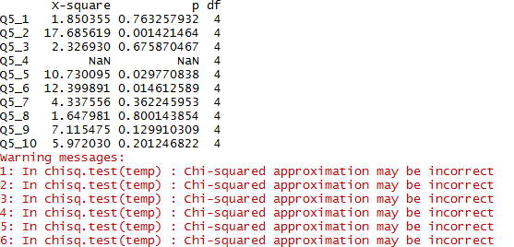
Next Steps & Other Work
Examine Survey Responses
Examine grades by soft drop
Examine office hours

